Slide 1
Basic Software Development Process Methodology Unit 3 – Screen
DD-MM-YY
PEG, KPIT Technologies
Notes:
Welcome to SDPM Training on “Screen Element”.
The goal of this session is to provide the complete information about the screen process like Definition of screen, Types of Screens, Classification of Screens, Screen views, Roles in the Screen process etc, within Uniphase framework.

Slide 2
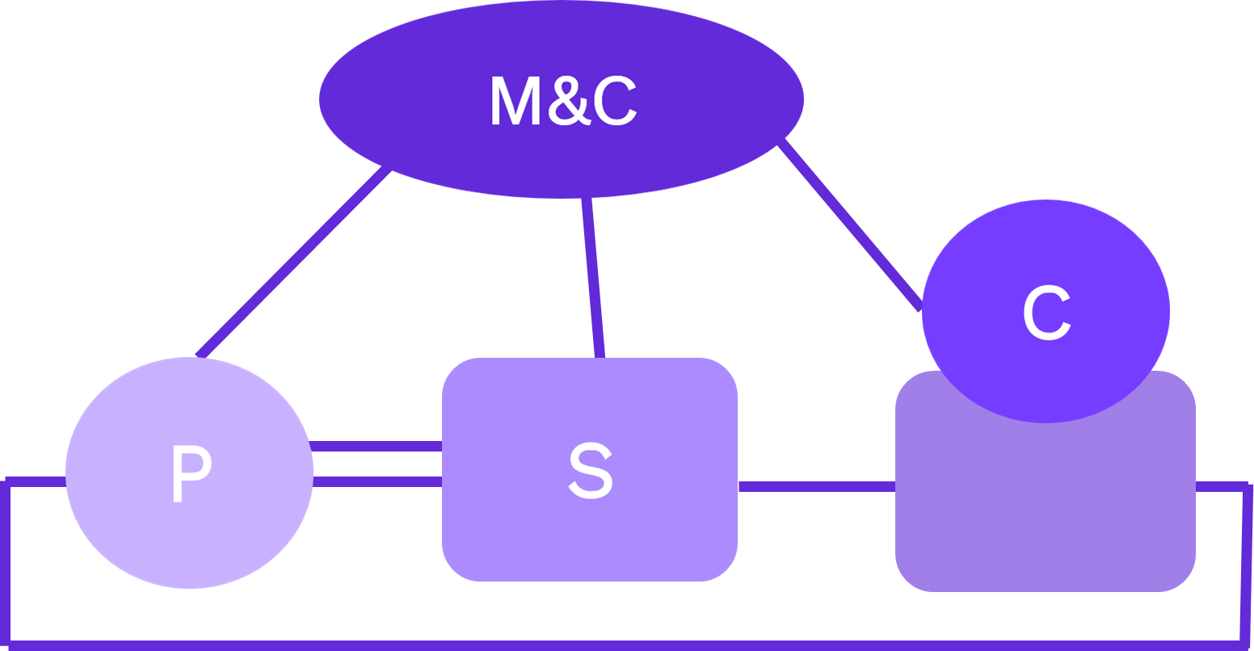
Uniphase
Notes:
The basic abstraction of the SDPM is Uniphase; which is composed of 4 basic elements: the Process (P), the Screen (S), the Store (C), and Management and Control (M&C).
The Uniphase Screen elements, identify the techniques, that verifies and validates the products produced by the Process elements.
Alternatively other organization call screen as ‘Peer review’ process

Slide 3
Purpose of Screen
Is to…
The Uniphase Screen elements identify the techniques that verify and validate products produced by the Process element and identifies the discontinuities.
Is Not to…
Criticize
Provide Suggestions
Notes:
The scope of the screen process is to identify the built-in error in the product and the correction mechanism that verifies and validates products.
The Screen Element identifies discontinuities that are associated with the input product, the down stream product, any other associated products, as well as screening for conformance to quality and configuration management standards
E.g.: If software Design is screened (verified & validated) against Software requirements, then screen process verifies & validate that all the customer requirements are converted into Design Element and design is sufficient enough to write code.

Slide 4
Scope of Screen
Verification
Have we done the job right?
Validation
Have we done the right job?
Effectiveness
Discontinuities that are not usually found during technical reviews.
Discontinuities that cannot be found through testing.
Minimize discontinuity fan-out through early detection and correction.
Notes:
By doing the screen, what we achieve?
Correct, Complete, and Consistent Product by doing verification & validation
Verification is done to check ‘Have we done the job right?’
Validation is done to check ‘Have we done the right job?’
Let us identify the differences, between verification, and validation?
Verification is a process, which confirms that specified requirements have been met.
Validation is a process, which checks that the product satisfies inputs, or fits the intended usage
The Effectiveness of screen is evaluated based on
Capturing defects escaped during technical reviews.
Identify defects not found in testing.
Minimize early detection and correction of defects

Slide 5
Screens Vs Technical Review
Technical Review | Screen
Performed during the process element | Final conformity check, performed after completion of Process Element
Is an internally performed, project’s internal event. | Is an independently performed, public event
Is an semi-formal QA process between peers. | Is a formal Quality Assurance process with multiple roles & views.

Slide 6
We’re Only Humans
Software is produced in the human mind. Processes, tools, techniques, etc. can only aid us in this highly complex human endeavor - and being human, we make mistakes. But following the rules of Screens can help us improve on our end result. Try this exercise. Put down your pen or pencil. Now count the number of times the letter “e” appears in this paragraph. And make a note.
Notes:
Count the number of times the letter “e” appears in this paragraph. And make a note. Total 38 appearances of e in the paragraph.

Slide 7
Types of Screens
Technical Screen Performed on Technical Products Focus is on Verification & Validation | Management Screen To ensure management Understands & Commits to the project Knows & Commits to solve the problems Understands and solves conflicts Understands and synchronize the stakeholders
Readiness Screen To ensure product is ready for next phase Readiness screen combines purposes of Technical and Management screens | Configuration Screen Perform functional inspection of the product to check against intended functionality. Performs physical inspection of the product to check against the configuration expectations of the product.
Notes:
There are two types of configuration screen as below:
Functional Configuration Screen: Ensure the product’s functional completeness by checking that all the product requirements can be traced to product functionality using the traceability matrices.
Note: In this screen there is no four mandatory views as in technical screen, however scope is functionality verification and validation.
e.g.: Test Report is performed functional configuration screen since the scope is narrow down to only verify & validate ‘PASS/FAIL’ conditions of testcases.
Physical Configuration Screen: Physically check that the product’s label has the correct information about the product, version and the customer name; that the product listing, version and the customer’s name appear in a file in the media in which the product is shipped; that all the deliverables are included in the package; and that the packaging is adequate for the mode of shipment.
e.g.: If the products is delivered to customer in the form of physical media (Manual, CD, DVD etc) the details available on the cover is verified and validated for correctness in the Physical Configuration Screen process.

Slide 8




Screen Roles
 | Person who selects and assigns Screen Team Leader Person who is responsible to take decisions in case of escalations.
 | The person assigned to head the Screening team. Assigning a good Screening Team Leader is the key to a successful Screen.
 | The person assigned to take notes.
 | The person represents the creator(s) of the products The person assigned to give a pre-screening briefing, answer questions and provide clarifications.
Screen Authority
Screen Team Leader
Scribe
Author
AND

Slide 9
Gentle Screener
Notes:
Screeners perform verification and validate of products. Also report discontinuities/defects present in the product and ensure defect-free product is released to customer.
The word GENTLE preceding Screener indicate the screeners should be polite, assertive, not aggressive or passive, make correct judgment etc.,
Teddy bear picture indicate qualities to be possessed by screeners

Slide 10

Screen Views
Mandatory Views
Additional Views
Quality Engineer
Screens for conformance to Q standards and evaluates the screen effectiveness.
Configuration Manager
Screens for conformance to CM standards.
Up Stream Provider
Screens for continuity with input document.
Down Stream Consumer
Screens for “do-ability” of next step.
Remember that testing may be a next step too.
User
Requirements Engineer
Designer
Coder
Tester
Hardware Engineer
Safety Engineer

Slide 11
Screening Team Size
Screening Teams should be limited to about 6 Gentle Screener.
A screening team member may be assigned more than one view.
Screen Authority may allow more than 6 Gentle Screeners in special circumstances as per his/her judgement.
Notes:
The size of a screen team is usually about 6 persons. This does not mean that the size should not exceed 6. It is a matter of judgment to select the optimum size.
The Upstream and Downstream views can be assigned to separate Gentle Screeners. There can be more than one person assigned with the same view.
For e.g. the Downstream view can be assigned to two or more persons, if the product being screened requires such an allocation. On the other hand, one person can also be assigned with more than one view. Typically, the Quality and CM views can be assigned to one Gentle Screener.

Slide 12
Screening Phases
Pre-Meeting Phase
Meeting Phase
Post-Meeting Phase
Those activities that must take place before a Screening team meeting can be effectively conducted.
Those activities that occur in the meeting.
Those activities that must take place following the meeting.`
Notes:
There are three stages in screen meeting as listed below:
1. Pre-meeting Phase:
Screen Team Leader screens the material, decides if the material is ready for screen, cancels screen if necessary, select screen Team assigns roles and views, schedules pre-screen briefing, distributes screening material
Screen Team Member attends the pre-screen, screens material from point of view assigned, records discontinuities, records exceptional continuities, returns discontinuity list to Screen Team Leader for consolidation.
The Author clarifies regarding any ambiguity in discontinuities, facilitates understanding of the material to the screening team prior to screen and also gives a pre-screen briefing, answers questions and provides clarifications
2. Meeting Phase:
Screen Team discuss on the discontinuities, and the Screen Team Leader determines if the product can be accepted, rejected, or conditionally accepted
3. Post-meeting Phase
The Screen Effectiveness Report is submitted, the Screen Team Leader reports screen results
Project Manager determines corrective action, if any, tracks corrective action to completion
Sends the Screened product to store after all discontinuities are corrected and no further discontinuities are found.

Slide 13
Major Discontinuities
If you find a major discontinuity:
Discuss it with the Author first.
You may be wrong.
Bring it to the attention of the Screening Team Leader.
The Screen may be postponed.
Notes:
If any major discontinuity is found in the product, first bring to the notice of STL. Based on discontinuity, STL shall take suitable decision whether to cancel screen or continue.
However don’t discuss/decide on discontinuity with Author before screen meeting because:
Author tries to convince/bias the screener
The purpose of screen is lost

Slide 14
After Individual Screening
The results are turned into the Screening Team Leader.
The Screening Team leader determines if the meeting is to be held, canceled, or delayed.
If the meeting is to go on, the Screening Team Leader distributes a composite of all of the individual reports for study prior to the meeting.
Notes:
After individual screening is completed, all findings are submitted to STL. The STL decides the meeting schedule, and dispatches the composite findings list. So that the screen team members, can come prepared for the screen meeting.

Slide 15
Screen Meeting
Reading Meeting
Author reads the material.
Screening team comments throughout.
Focuses on one segment at a time.
Good synergy between the Screeners.
May not see the forest for the trees.
By Exception Meeting
Each Gentle Screener presents discontinuities in turn.
Focuses on one view point at a time.
Thorough discussion of view.
May not see the trees for the forest.
Notes:
The two different methods of screen meetings are:
1. Reading screen Meeting :
The author reads the product and screen team members provide their views/comments on the product.
Advantage of this method is:
Focuses on one segment at a time
Good synergy between the screeners
May not see the forest for the trees
2. By Exception screen Meeting
Here each gentle screener presents the discontinuities when their turn comes.
Advantage of this method is:
Focuses on one view point at a time
Detailed discussion on each discontinuities
May not see the tress for the forest

Slide 16
Meting Do’s
Be objective
Stick to pointing out discontinuities and exceptional continuities.
Be courteous
The author has feelings.
Be prepared
Calling a “No Screen” because you are not prepared is a serious process discontinuity.
Be punctual
A Screen should not last more than 2 hours.
Start on time - end on time.
Be professional
Notes:
Ensure below Do’s in screen meeting:
Should be able to interpret the discontinuities with objective evidence
Should be assertive, not aggressive or passive
Should be Punctual: A Screen should not last more than 2 hours. Start on time - end on time
Be prepared: Calling a “No Screen” because you are not prepared is a serious process discontinuity.
Untrained persons can be non-active participants for training purposes.

Slide 17
Meeting Do Not’s
Step out of your role.
Lose your point of view.
Tell everyone how you would do it.
It’s not your assignment.
Offer suggestions.
It’s not the time or the place.
Allow visitors to attend a Screen.
Have more than about 6 people in the meeting.
Allow untrained persons to be active participants in the meeting.
Untrained persons can be non-active participants for training purposes.
Forget you are a professional.
Notes:
Ensure below Do not’s in screen meeting:
Do not allow, visitors to attend a Screen.
Do not have, more than about 6 people in the meeting.
Do not allow, untrained persons to be active participants in the meeting.
And. Do not forget, you are a professional.

Slide 18
Meeting Activities
Author
May present material in a reading meeting.
Answers questions.
May not have participated in product development.
Screening Team Leader
Keeps the meeting focused.
Ensures that the meeting is conducted properly.
Stops the meeting if necessary.
Determines product status.
Accepted
Not Accepted
Conditionally Accepted
Notes:
This slide provides information on activities performed by Author & STL in a screen meeting.
All the screen team members shall adhere to their ROLE & VIEW in the screen meeting.

Slide 19
Meeting Activities
Gentle Screener
Identifies discontinuities.
May be misunderstood by Screener.
May be clarified by Author.
Identifies exceptional continuity.
Participates.
In discussions.
Raises new questions.
Everyone
Maintain role.
Maintain view.
Scribe
Notes relevant discussions.
Notes new discontinuities.
Notes new well done continuities.
Quality Engineering
Monitors Screen effectiveness.
Notes:
This slide provides information on activities performed by Gentle screener, Scribe & Quality Engineer in a screen meeting.
All the screen team members shall adhere to their ROLE & VIEW in the screen meeting.

Slide 20
Post-Meeting Activities
Scribe
Promptly turns in the Meeting Minutes.
Quality Engineer
Submits the Screen Effectiveness Report.
Verify the closure of findings.
Screening Team Leader
Reports screen results.
Screens and distributes meeting minutes.
Assigns Rework Screener(s) from the screen team and explains the scope of Rework Screen.
Project Leader
Determines corrective action, if any, with real author's).
Established corrective action priorities.
Tracks corrective action to completion.
Notes:
This slide provides information on activities performed by Scribe & Quality Engineer, STL & Project Lead after screen meeting.
All the screen team members shall adhere to their ROLE & VIEW in the screen meeting.

Slide 21
Post-Meeting
If you had a suggestion during the meeting talk to the Author in private after the meeting.
If you don’t agree with the outcome of the Screen talk to the Screening Team Leader in private after the meeting.
Use the management.
Notes:
Discuss with author about discontinuity/suggestions in detail or provide more clarity on discontinuity after the post meeting. If required involve STL for resolution or take management support.

Slide 22
What Setting the Screen Does
Defining the Set information for the Screen elements identifies the built-in error detection and correction mechanism that verifies and validates all products.
Notes:
Setting screen information includes setting the screen notes outline. These are listed in next slide.

Slide 23
It’s Not Personal
Concentrate on interpersonal skills.
It may never feel good having your product criticized.
Keep in mind that it is not your product, it is our product.
Notes:
As part of screen team member:
Don’t take personal the outcome of screen process
Have positive attitude in screen meeting
Be analytical and open minded in screen process

Slide 24

Thank You

